Slide 1
2012 National Association of State Student Grant & Aid Programs Conference FAFSA Application Update
Misty Parkinson | 10.15.2012

Slide 2
Agenda
2012-2013 Application Statistics
2012-2013 Mid-cycle Enhancements
2013-2014 Application Changes and Enhancements
State Application Programming Interface (API)
FAFSA Completion Pilot Project
FAFSA Completion Tool for High Schools

Slide 3
2012-2013 Application Statistics

Slide 4
Application Statistics
The following statistics are for applications submitted
January 1 - September 30
Transaction Source | 2012-2013 | 2011-2012
Web | 16,437,268 | 16,061,798
EZ Web | 2,175,909 | 2,443,125
Paper | 41,268 | 65,864
Electronic Other | 97,510 | 183,078
Notes:
Web = FOTW and FAA Access
EZ Web = simplified path (based on state of legal residence and eligibility for AZ, student able to skip questions that aren’t required for EFC calculation)
Point out decrease in paper (about 30%) and EDE (nearly 50%). Decrease in EZ Web likely results from AZ threshold change from 31,000 in 11/12 to 23,000 in 12/13
Overall, we’re about equal between the two year. ACSI score is also stable – fluctuates between 88 and 90, which is defined as outstanding

Slide 5
Application Statistics
The following statistics are for dependent student applications from January 1, 2012 - September 30, 2012
Application Type (English) | Number of applicants | Average Completion Time (in minutes)
FAFSA | 3,455,616 | 37:04
EZ FAFSA | 329,120 | 32:02
Renewal | 4,003,109 | 27:13
EZ Renewal | 394,268 | 19:52
Application Type (Spanish) | Number of applicants | Average Completion Time (in minutes)
FAFSA | 28,833 | 34:56
EZ FAFSA | 7,003 | 38:29
Renewal | 41,871 | 21:02
EZ Renewal | 11,849 | 23:48
Notes:
FOTW only

Slide 6
Application Statistics
The following statistics are for independent student applications from January 1, 2012 - September 30, 2012
Application Type (English) | Number of applicants | Average Completion Time (in minutes)
FAFSA | 3,879,269 | 19:03
EZ FAFSA | 594,765 | 16:31
Renewal | 4,894,169 | 14:36
EZ Renewal | 774,079 | 10:60
Application Type (Spanish) | Number of applicants | Average Completion Time (in minutes)
FAFSA | 25,841 | 21:51
EZ FAFSA | 5,237 | 24:02
Renewal | 40,462 | 12:56
EZ Renewal | 7,016 | 15:60
Notes:
FOTW only

Slide 7
IRS Data Retrieval Tool (IRS DRT) Statistics
As of July 15th, the volume of successful authentications with the IRS for the 2012-2013 cycle surpassed the entire volume of successful authentications for 2011-2012
As of September 23rd (when 2011-2012 correction processing ended and the IRS DRT was no longer available for that year), 5,198,417 unique users had successfully authenticated for 2011-2012
As of September 30th, 7,160,227 unique users have successfully authenticated for 2012-2013
For 2013-2014, the IRS DRT is scheduled to become available on February 3rd

Slide 8
2012-2013 Mid-cycle Enhancements

Slide 9
Mid-cycle Enhancements
Case sensitivity for PIN challenge response was removed
Automatic e-mailing of confirmation page began
Applicants now receive an alert when e-mail address not entered
Browse Help and Contact Us pages were merged
Notes:
Case sensitivity, confirmation page – based on calls received at FSAIC
E-mail – to allow for improved communication with applicants
Browse Help/Contact Us – to make it easier for users to find the help they need in one place
discuss additional changes coming up for help page (section for IRS DRT topics at start-up, and redesign in April)
Mention IFAP announcements for mid-cycle enhancements – explain that Summary of Changes to the Application Processing System Guide (to be posted within the next month) explains FOTW enhancements for start-up. Electronic announcements will be posted prior to midcycle enhancements, which typically occur in April, July, and September

Slide 10
Mid-cycle Enhancements
The Home Page now reflects the new look and feel for Federal Student Aid
Based on customer feedback the options on the Home Page now reflect how applicants should access the FAFSA based on their filing status

Slide 11
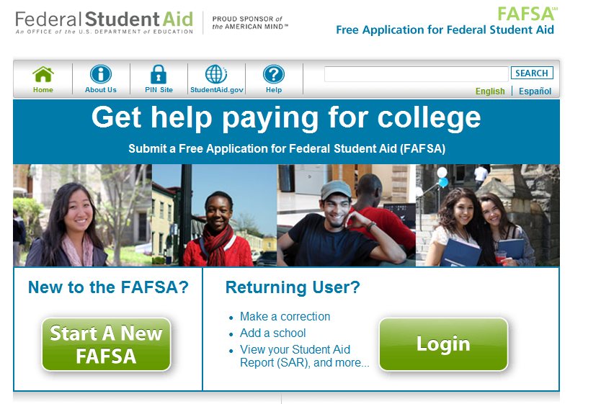
Notes:
Both buttons link to the same place (Login page), but we believe the two buttons are less confusing than the one “Start Here” button

Slide 12
2013-2014 Application Changes and Enhancements

Slide 13
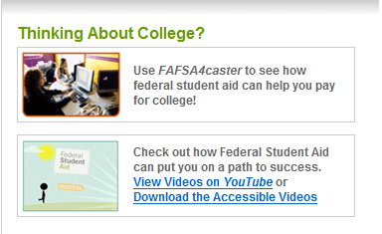
Integration of StudentAid.gov and YouTube
URLs for discontinued Web sites will be replaced with references to StudentAid.gov
Users will be able to link to Federal Student Aid’s YouTube videos from FAFSA on the Web home page
Notes:
Studentaid.ed.gov, college.gov, federalstudentaid.ed.gov, ombudsman.ed.gov
New videos in the works. Current videos are “Overview of the Financial Aid Process” and “FAFSA Overview”
Replaces link to PSA

Slide 14
Enhanced Browser Detection
Browsers that were tested and determined to be incompatible with FAFSA on the Web will continue to be blocked
All other browsers, current & new, will be supported and the unsupported browser message will no longer display
Notes:
Mention OS issues

Slide 15
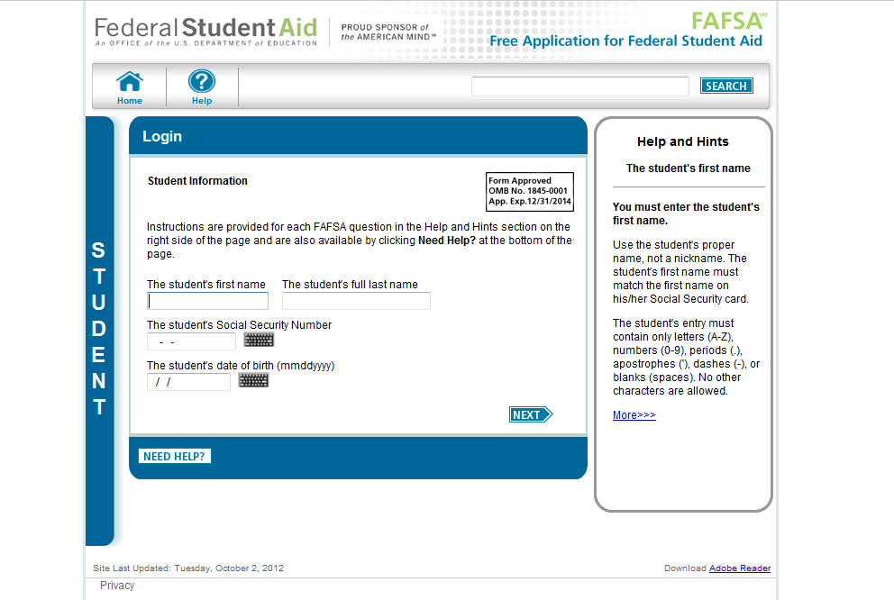
Notes:
Unsupported browser message used to display here and caused confusion

Slide 16
New Messaging for Estimators
Instructional text will display for applicants who indicate they “Will file” their taxes

Slide 17
Enhanced IRS DRT Questions
The format of the IRS Data Retrieval Tool filtering question will be enhanced
Question labels will be improved for clarity
Notes:
Wording of recently filed question clearer
Radio buttons instead of checkboxes

Slide 18
Enhanced “Sign & Submit” Page
Modify preparer question to include link to help topic
Make PIN signature option most prominent
“Sign with PIN” will be the default signature option for most applicants
Users can choose another option for signing, and when selected, the system will display options to use PIN, print a signature page, or submit without signatures, along with definitions for each

Slide 21
Improved Confirmation Page
New text informs applicants that eligibility for federal aid is dependent on meeting eligibility guidelines
What Happens Next? section enhanced and relocated
Applicants will now have option to share on Facebook or Twitter that they completed their FAFSA

Slide 22
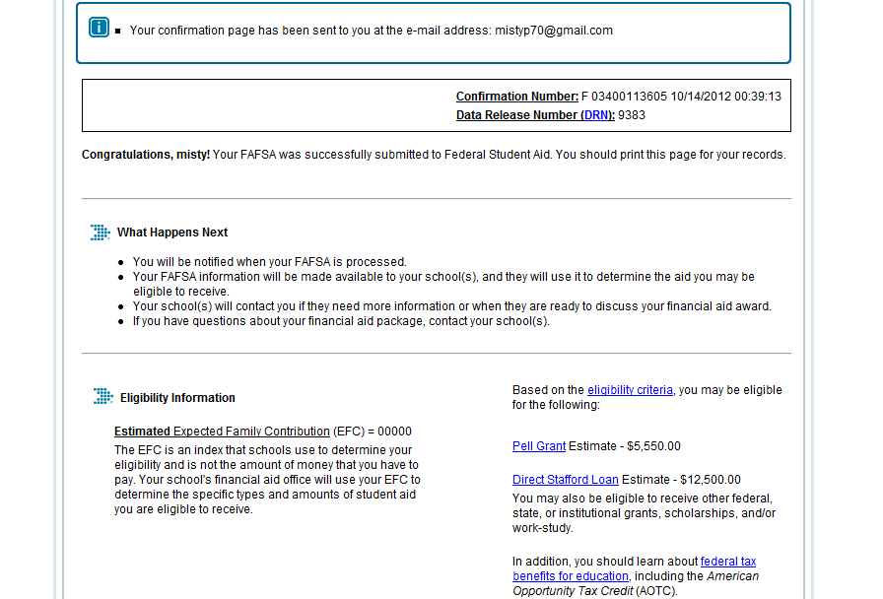

Slide 23
Additional Application Updates
Any references to the terminology “Food Stamps” will be changed to “Supplemental Nutrition Assistance Program (SNAP)”
All students with a high school diploma will be required to provide the high school’s name, city and state
Automatic Zero EFC threshold will change from $23,000 to $24,000
Notes:
SNAP change was made based on guidance from the Office of Postsecondary Education
HS – currently only required from those with grade level 0 or 1

Slide 24
State Application Programming Interface (API)

Slide 25
State API
The State API provides students with the option to transfer the information provided in their FAFSA directly into their state application
In order to participate a state agency must have a web-based version of the state application that applicants are required to complete in order to determine eligibility for state-based student aid
The state agency must also develop the capability to electronically interface with FAFSA on the Web

Slide 26
State API
States that currently participate:
California
Iowa
Mississippi
New Jersey
New York
Pennsylvania
Vermont
New for 2013-2014:
Minnesota

Slide 27
State API
States that are interested in participating for 2014-2015 must attend a briefing session which will be scheduled for spring 2013
To find out more information about the State API please refer to the Electronic Announcement posted to IFAP on April 23, 2012
Subject: Invitation to States for Participation in Application Programming Interface with FAFSA on the Web
Contact Andrea Bell (Andrea.Bell@ed.gov) or Valerie Lefor (Valerie.Lefor@ed.gov) for additional information

Slide 28
FAFSA Completion Pilot Project

Slide 29
FAFSA Completion Pilot Project
In 2010, the U.S. Department of Education implemented a FAFSA Completion Project designed to assist local educational agencies (LEAs) and secondary school administrators in determining which of their students have completed a FAFSA for the upcoming school year
FAFSA completion information provided under the FAFSA Completion Project can help LEAs and secondary schools in implementing targeted outreach efforts to assist their high school seniors and their families who have not yet submitted a FAFSA, or who submitted a FAFSA that may be incomplete
Notes:
20 selected for first cohort

Slide 30
FAFSA Completion Pilot Project
92 new school districts, spanning 30 states, were recently selected for the FAFSA High School Completion Project. These 92 sites join the initial cohort that received data for the 2011-2012 school year as part of the FAFSA Completion Project’s initial pilot
The school districts will be able to track whether high school seniors have completed the FAFSA starting in the 2012-2013 school year
This information will help school guidance counselors focus efforts and resources on students who have not yet completed a FAFSA
Notes:
Disclosure issue still on table – FAFSA Completion data – not full ISIR
Need data sharing agreement, etc.
Long term solution – possibly states.
Short term solution – allow ED grantees with relationship to district to share data
New sites were randomly selected and consist of 80 school districts with multiple high schools and 12 districts with a single high school
To evaluate the effectiveness of local level counseling, districts with multiple high schools will have a staggered roll out
The districts will establish an experimental group and a control group by giving half of participating schools access to the FAFSA data in year one of the project, then adding the remaining half of schools the following year
The Department’s Institute of Education Statistics will publish a report that summarizes the findings of the 80 multi-high school districts

Slide 31
FAFSA Completion Tool for High Schools

Slide 32
FAFSA Completion Tool for High Schools
Historically, high schools relied on self-reported surveys to estimate their FAFSA completion rates. These completion rates typically exceeded actual rates by 25-50%
Federal Student Aid is providing high schools with current data about their FAFSA submissions and completions so that high schools can track their progress and help to ensure that their students complete a FAFSA
Notes:
Aggregate level data by HS, compared to FAFSA Completion Project, which allows districts to get student-level data. Participants in Pilot are being asked to use this tool to build baseline, but anyone can use this tool

Slide 33
FAFSA Completion Tool for High Schools
The data available reflects the number of submitted and completed FAFSAs among applicants no older than 18 who will have received their high school diploma by the start of the 2012-2013 school year
The data is displayed in spreadsheets broken down by state or territory that include the school name and city of the high school
Additional information can be found at http://studentaid.ed.gov/about/data-center/student/application-volume/fafsa-completion-high-school

Slide 35
Questions?

