Slide 1


National Association of Student
Financial Aid Administrators
NASFAA Update
Stephen Payne
NASSGAP - Albuquerque
October 18, 2018

Slide 2
Agenda
Inside the Beltway
Outlook
  Higher Education Act Reauthorization
    PROSPER Act
    Aim Higher Act
  Federal Budget & Funding
Department of Education Update
NASFAA Update
Opportunities for Advocacy

Slide 3
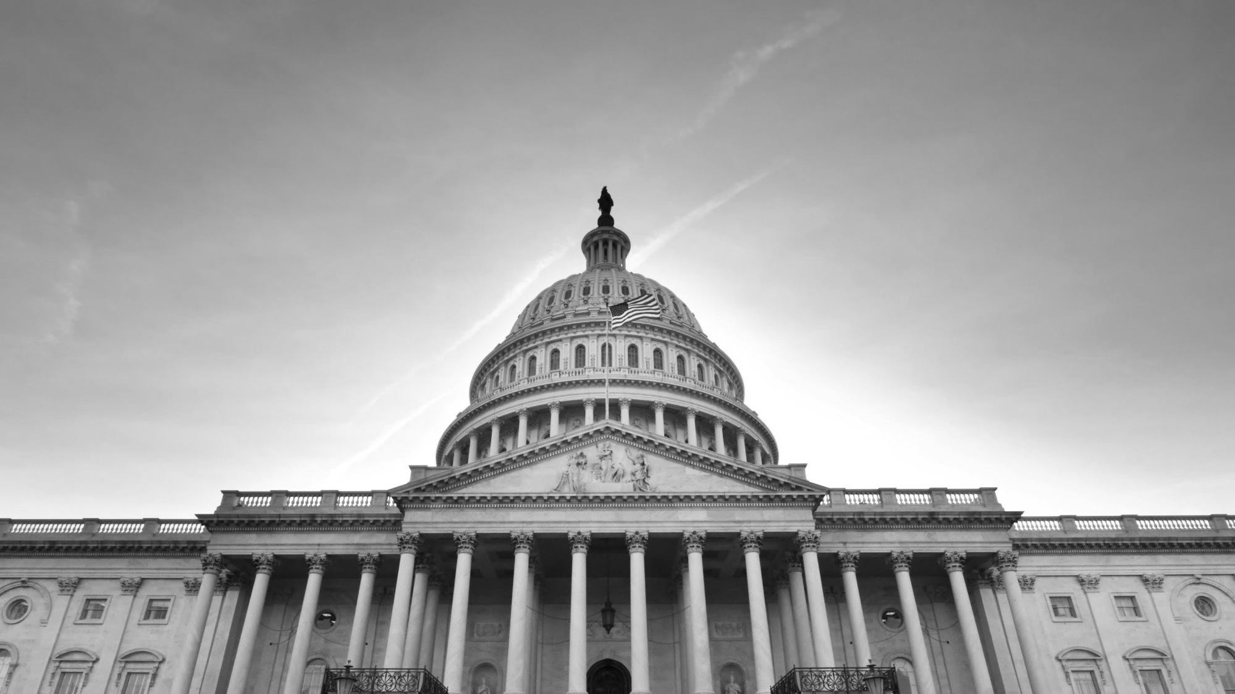
Inside the Beltway

Slide 4
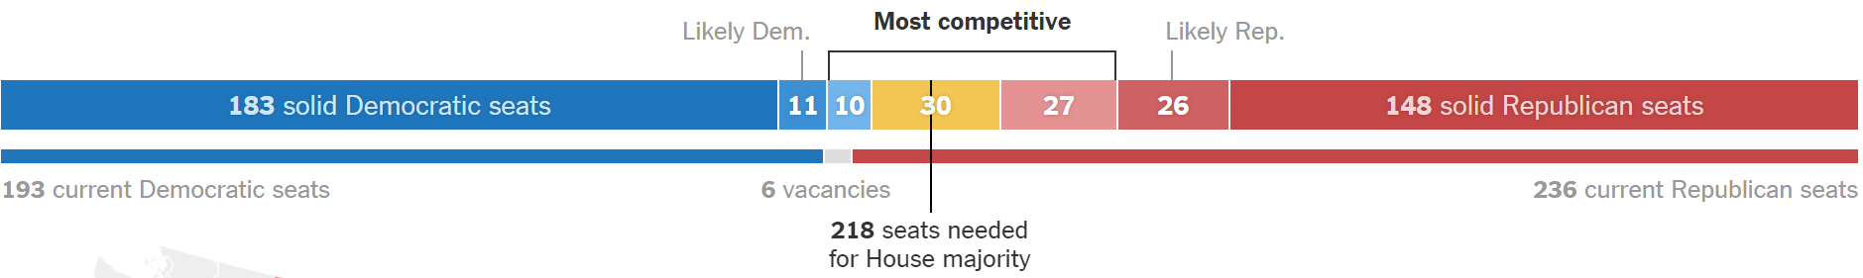
2018 Midterms - House
Source: The New York Times

Slide 5
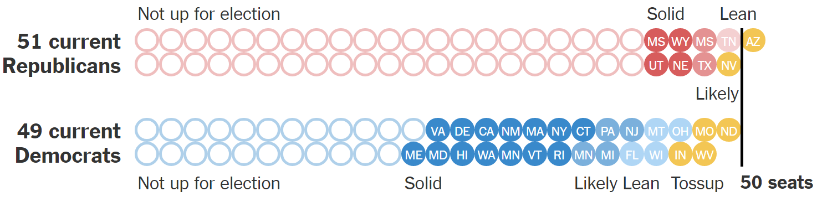
2018 Midterms - Senate
Source: The New York Times

Slide 6
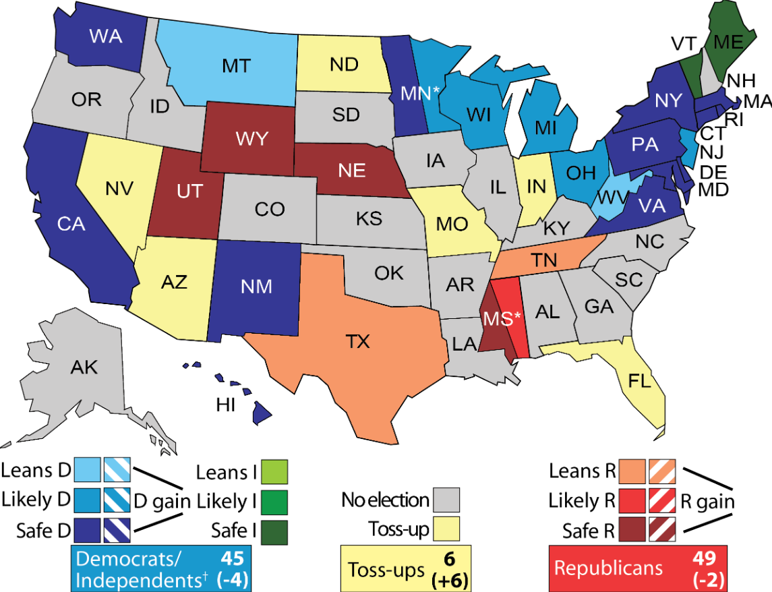
2018 Midterms - Senate
Source: UVA Center for Politics

Slide 7
Tax Reform
Tax Cuts and Jobs Act signed into law December 2017
Original House bill eliminated:
  Student loan interest deduction
  Lifetime Learning Credit
  Employer-provided educational assistance benefit
  Tuition reduction benefit for university employees
Final bill did not include many of the negative provisions in the House tax bill
  However, the bill did include an endowment excise tax
Final bill would make amounts discharged under death or total and permanent disability provision non-taxable

Slide 8
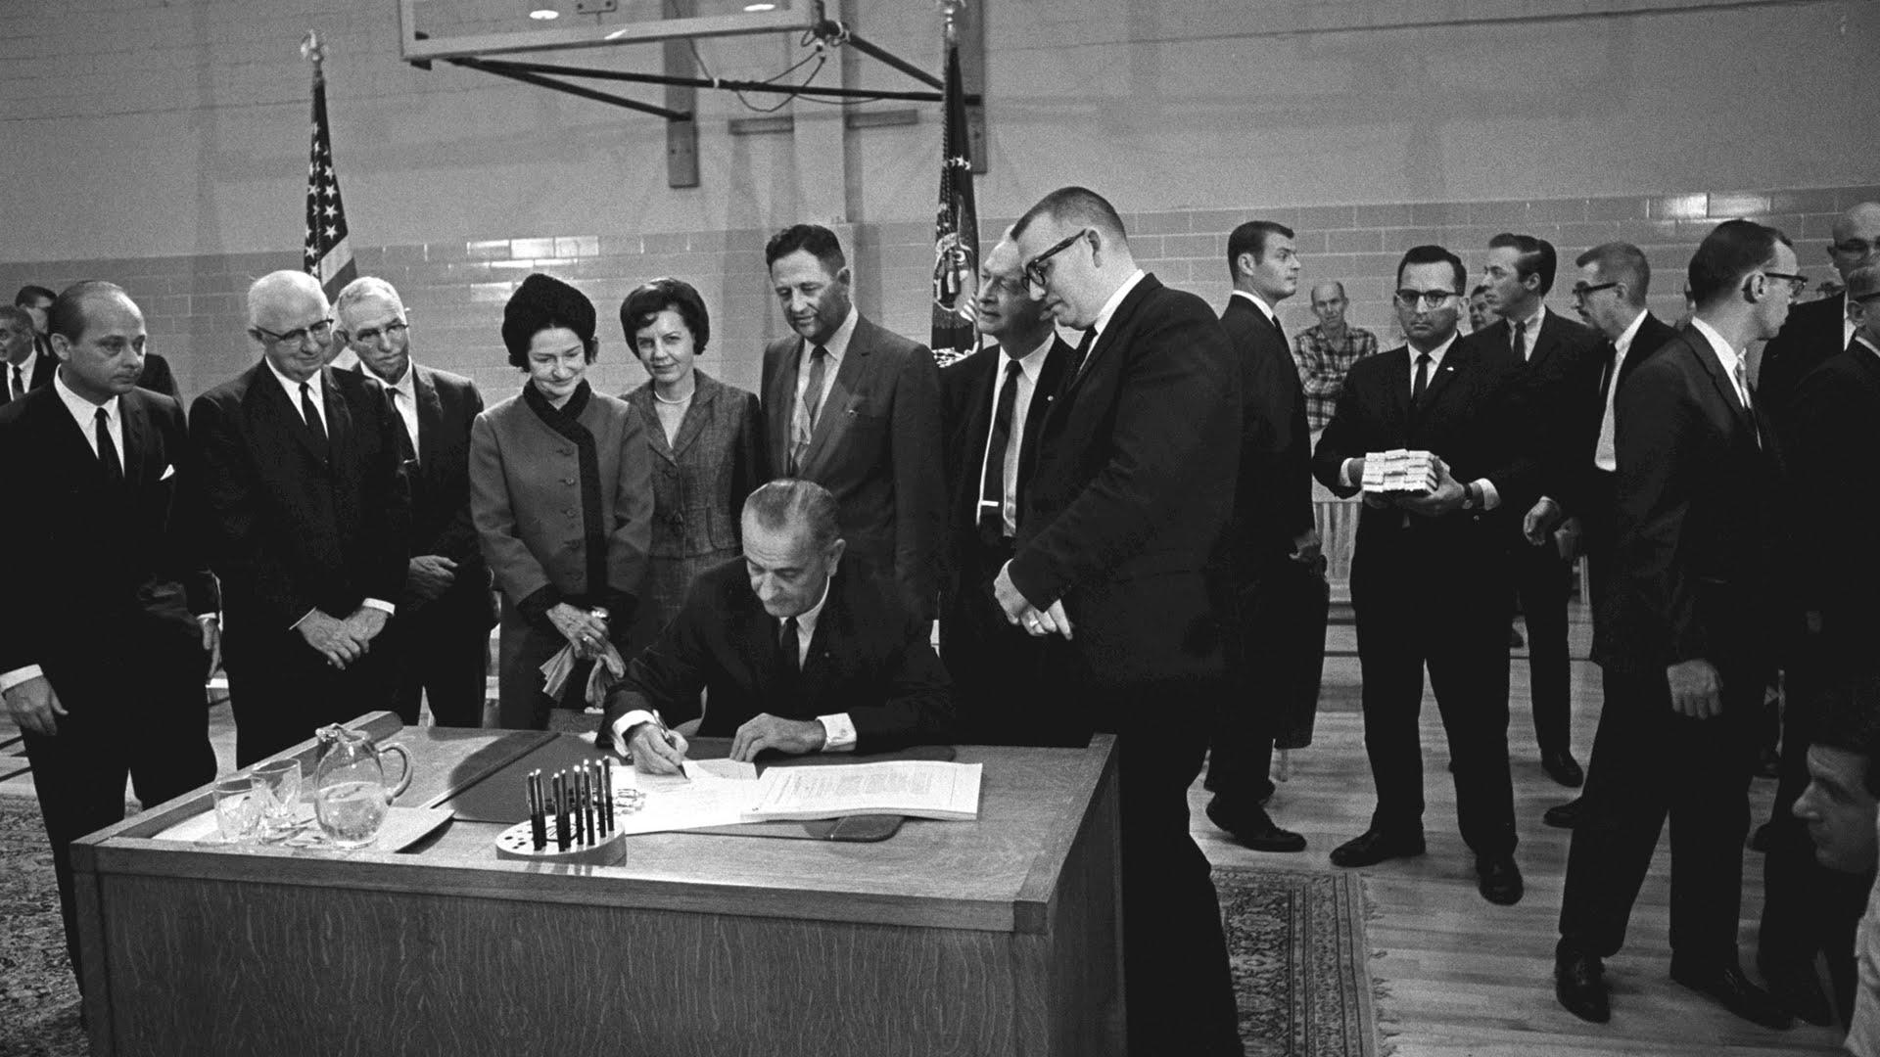
HEA Reauthorization

Slide 9
HEA Reauthorization
Last reauthorization in 2008
  Current version of HEA technically expired in 2013
House
  Republicans: Promoting Real Opportunity, Success and Prosperity Through Education Reform (PROSPER) Act
    Passed House education committee in December 2017
    Will not reach a floor vote before midterm elections
  Democrats: Aim Higher Act
    Introduced July 2018
Senate
  In May, Sen. Alexander said his committee will not produce HEA legislation this year

Slide 10
HEA Issue Priorities
Issue | House Republicans | House Democrats | Senate Republicans | Senate Democrats
“One Grant, One Loan” | ✓ |  | ✓
FAFSA simplification | ✓ | ✓ | ✓
Risk-sharing | ✓ | ✓ | ✓ | ✓
Free college for two years |  | ✓ |  | ✓
Pell Grant increases tied to inflation |  | ✓ |  | ✓
Pell Grants for short-term programs | ✓ | ✓
Eliminate origination fees | ✓ | ✓
Loan refinancing |  | ✓ |  | ✓
Campus-based aid allocation formula changes | ✓ | ✓ |  | ✓

Slide 11
PROSPER Act Overview
Substantially decreases federal investment in student aid
  Level-funds Pell Grant – does not index to inflation
  Eliminates 7+ major federal student aid programs (including FSEOG, subsidized loans, Grad PLUS, PSLF, TEACH, FWS eligibility for grad students, etc.)
Includes positive attempts to streamline
  FAFSA simplification, elimination of origination fees, institutional authority to limit loans, FSA reform and accountability, streamlines repayment options
Alters accountability standards
  Return to Title IV
  Repeals gainful employment, 90/10 rule

Slide 12
Aim Higher Act Overview
Substantially increases federal investment in student aid
  Pell Grant - Increases maximum award by $500; permanently indexes to inflation; increases mandatory funding share to 60%
  Maintains all current programs, increases funding for many of them
Includes positive attempts to streamline
  FAFSA simplification, elimination of origination fees, streamlines repayment options
Maintains and strengthens accountability standards for certain institutions
  Maintains gainful employment provision
  Changes 90/10 rule to 85/15

Slide 13
HEA Reauthorization: Long Way to Go…
 | PROSPER | Aim Higher
1. Introduce in the House | ✓ | ✓
2. House Committee mark-up | ✓
3. Pass out of Committee | ✓
4. Pass out of full House
5. Senate introduces comprehensive bill
6. Senate Committee mark-up
7. Pass out of Committee
8. Pass out of full Senate
9. Conference House & Senate bills
10. Both chambers pass final version
11. President signs into law

Slide 14
Annual Counseling Provisions
The Empowering Students Through Enhanced Financial Counseling Act passed the full House on September 5th by a vote of 406-4
  Previously passed the full House in 2014 (by a vote of 405-11) and in 2016 (by voice vote). The Senate did not consider it in either session.
The bill would require:
  All Pell recipients and Direct Loan borrowers (including Parent PLUS), to receive annual counseling before disbursement
  All borrowers to accept loans annually by signing a master promissory note (MPN) or written statement
  Institutions to provide new exit counseling information

Slide 15
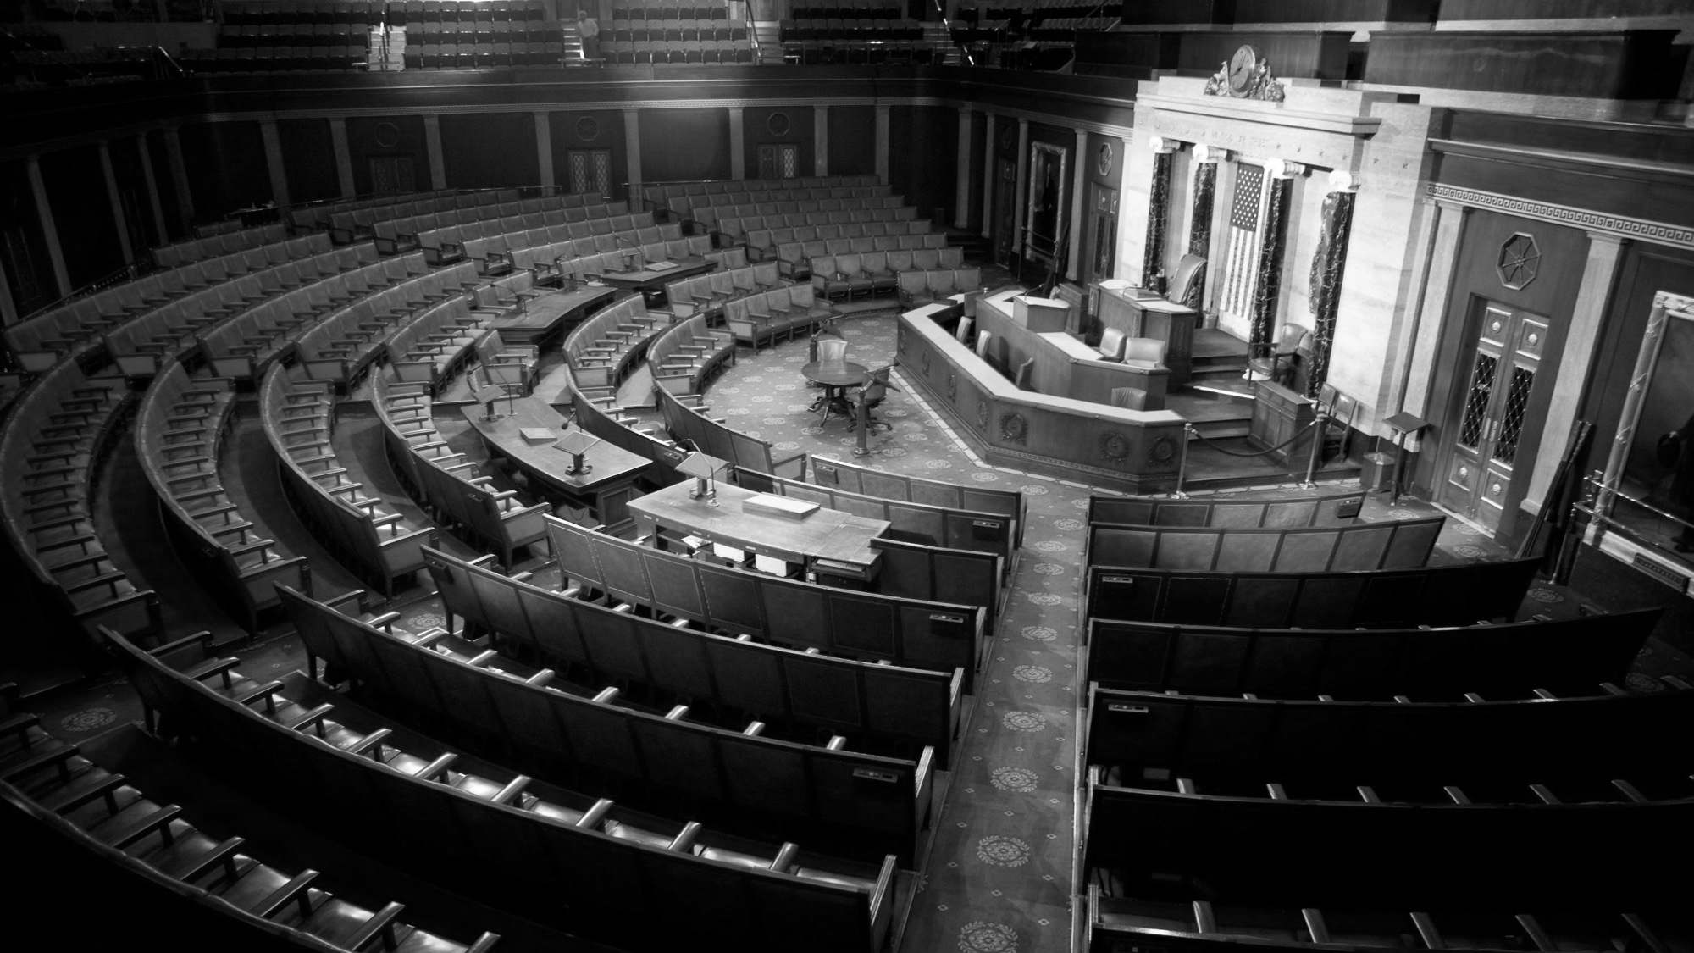
Federal Budget & Funding

Slide 16
FY 2018 Appropriations Package
Funding Provisions:
Additional Provisions:
Expanded FAFSA data-sharing
Children of Fallen Heroes Scholarship Act
ED required to include and evaluate multiple servicers in “NextGen Financial Services Environment”
Pell Grant
Increases maximum Pell Grant award by $175 to $6,095 (first year without automatic inflation increase)
Federal Supplemental Educational Opportunity Grant (FSEOG)
Increased funding by $107 million to $840 million
Federal Work Study (FWS)
Increased funding by $140 million to $1.1 billion
Public Service Loan Forgiveness (PSLF)
$350 million for borrowers who were enrolled in ineligible repayment plans – first come, first served account - $700 million total over 2 years

Slide 17
FY 2019 NASFAA Requests
NASFAA letter to House and Senate appropriations leaders made the following requests for FY 2019:
  Boost maximum Pell Grant to $6,230
  Protect Pell reserve fund
  Increase funding for FWS and FSEOG
  Fund Perkins cancellations
  Support other important programs like TRIO and GEAR UP

Slide 18
FY 2019 Appropriations Update
House and Senate leaders agreed on funding levels for FY 2019 defense, labor, health, and education programs in September
President Trump signed the package into law on September 28
First “regular order,” on-time passage of education funding in over two decades (since 1996)

Slide 19
FY 2019 Appropriations Package
Funding Provisions:
Additional Provisions:
Expanded FAFSA data-sharing
Deferment for Active Cancer Treatment Act
ED allowed to use Student Aid Administration funds to support Perkins Loan servicing (though unlikely)
ED required to include and evaluate multiple servicers in “NextGen Financial Services Environment”
Pell Grant
Increases maximum Pell Grant award by $100 to $6,195 (funded in part by a $600 million rescission from reserves)
Federal Supplemental Educational Opportunity Grant (FSEOG)
Level-funded at $840 million
Federal Work Study (FWS)
Level-funded at $1.1 billion
Public Service Loan Forgiveness (PSLF)
$350 million for borrowers who were enrolled in ineligible repayment plans – first come, first served account - $700 million total over 2 years

Slide 20
FY 2019 President’s Budget vs. Passed Bill
Trump Budget Proposal | Final Appropriations Bill
Flat-lines Pell maximum award | Increases Pell maximum award by $100
N/A | Cuts $600 million from Pell reserves
Eliminates FSEOG | Level-funds FSEOG
Cuts FWS by $500 million; limits eligibility to undergraduates | Level-funds FWS
Eliminates in-school interest subsidy, PSLF; consolidates IDR plans | Additional $350 million for borrowers enrolled in ineligible PSLF plans

Slide 21
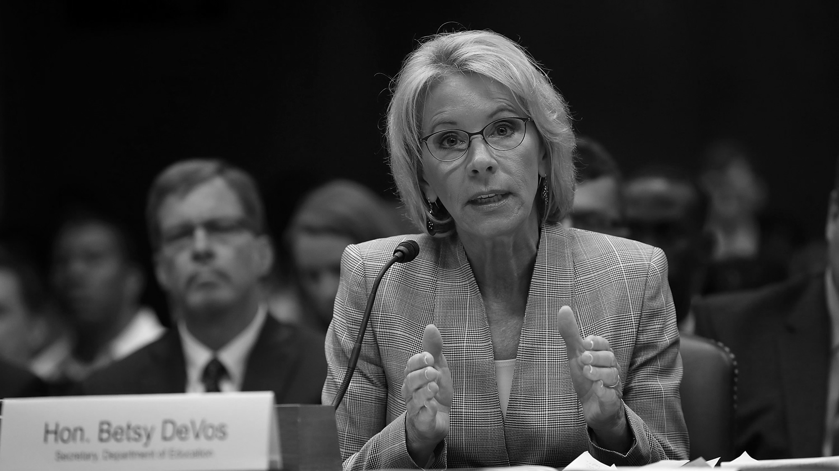
Department of Education

Slide 22
Department of Education Outlook
“Next Generation Processing and Servicing Environment”
  Single loan portal and multiple servicers
  Modifications and amendments made to solicitation in 2018
  In September, ED announced finalists for servicers to receive contracts
“FSA Payment Card Program” pilot
  Originally scheduled to launch in the spring of 2018
  Solicitation published on October 16 for mobile “myMoney” student aid disbursement program through myStudentAid app

Slide 23
Negotiated Rulemaking
Two rulemaking sessions in early 2018:
  Borrower Defense to Repayment and Financial Responsibility
  Gainful Employment
Notice of Proposed Rulemaking (NPRM) and public comment period in summer 2018
According to reports, ED will not finalize these rules by November 1 (for an effective date of July 1, 2019), meaning earliest implementation would be July 1, 2020
Delay of Obama-era borrower defense to repayment rules judged to be unlawful in court case
  Tied up in courts, unknown what will happen

Slide 24
Upcoming Negotiated Rulemaking
Topics for rulemaking sessions planned for early 2019:
    Accreditation
    State authorization
    Definition of credit hour
    Teach-outs
    Barriers to innovation, competition, or completion, graduation, or employment
    Direct assessment/Competency-based education
    TEACH Grant
    Faith-based entities

Slide 25
Future of Perkins Loan Program
Unlikely that Congress will choose to extend the program
ED will post a notice in December with due balances and deadline information
NASFAA has shifted advocacy to ensure an equitable close-out of the program, requesting that schools maintain their share of their fund for:
  Unreimbursed cancellations
  Cases where institution chose to assign portfolio to ED

Slide 26
USCIS Public Charge Rule
Trump Administration proposing to redefine the term “public charge”
Would require consideration at the time a noncitizen seeks admission to the United States or seeks adjustment, extension, or change of immigrant or nonimmigrant status, of the receipt and/or use of public benefit programs as a determinant of “public charge inadmissibility”
Proposed rule explicitly excludes education benefits (though previous leaked drafts did not)
However, students may still avoid education benefits for fear of the perception of this rule for themselves and/or their families

Slide 27
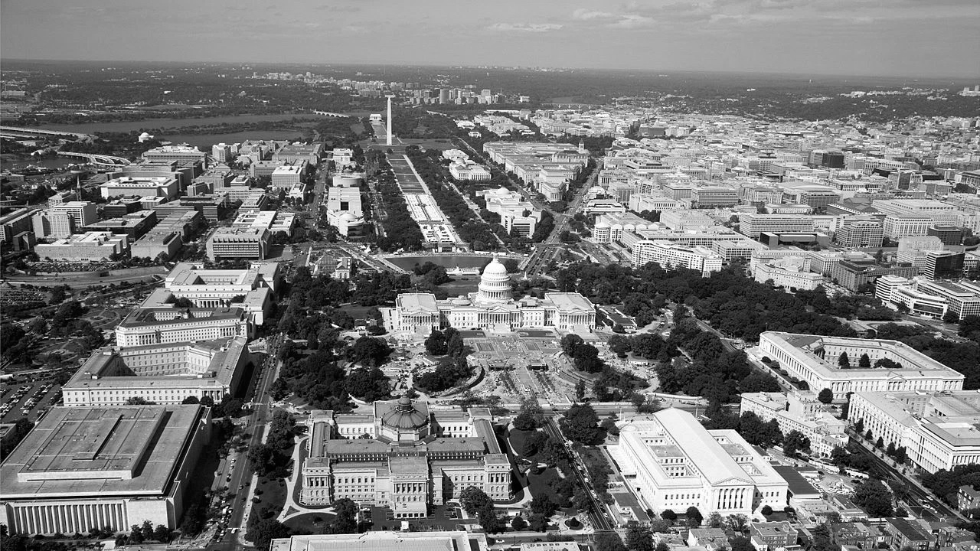
NASFAA Update

Slide 28
NASFAA’s Recent Work on Award Notifications
In June, the NASFAA Board of Directors voted to endorse a recommendation to Congress to standardize terms and elements on award notifications
  Recommendation would incorporate NASFAA Code of Conduct into statute
For more information:
  nasfaa.org/Improving_Award_Notifications

Slide 29
NASFAA’s Recent Work on Award Notifications
NASFAA has identified four elements that belong in an award notification:
  Breakdown of estimated individual COA components, including which are direct (billed) costs vs. indirect (non-billed) costs;
  Clear identification and proper grouping of each type of award, indicating whether the aid is a grant/scholarship, loan, or work program;
  Estimated net cost; and
  Standard terminology, including for example, common definitions for net price/cost.

Slide 30
PPY and Early FAFSA
Advocates have paid increasing attention to state financial aid priority deadlines and institutional priority deadlines.
Has/Is your state…
  moved up state aid deadline(s) immediately following Early FAFSA implementation?
  waited to move up state aid deadline(s) following Early FAFSA implementation until a year or two in?
  considering moving up state aid deadline(s) in the future?
  choosing not to modify state aid deadline(s) at all?

Slide 31
Higher Education Committee of 50
Background:
  NASFAA received a grant from the Bill & Melinda Gates Foundation to form The Higher Education Committee of 50
  Committee members represent almost every office on a college campus and are forward-thinking leaders

Slide 32
Higher Education Committee of 50
The primary purposes of the Higher Education Committee of 50 are to:
  Identify emerging policy issues that impact students and the higher education landscape, with a focus on four specific policy areas: access, affordability, transparency, and accountability
  Create practical solutions and recommendations for members of Congress
  Elevate the principles and positions put forth by the Higher Education Committee of 50 after the grant has ended

Slide 33
Higher Education Committee of 50
Members represent the following offices:
President
Provost/Dean
Chancellor
Governing Body
System Head
General Counsel
Ombudsperson
Enrollment Management
Financial Aid
Registrar
Admissions
Business
Student Affairs
Disabilities/Equity and Diversity
IT
Institutional Research
Human Resources
Online Learning
Faculty
Student

Slide 34
Higher Education Committee of 50
Project Timeline:
  Fall 2018: NASFAA shares proposed recommendations with NASFAA members and the membership of other associations for public comment and feedback
  Winter 2018: Committee approves final recommendations
  Winter-Spring 2019: Final recommendations are published and shared with policymakers

Slide 35

#Fight4FinAid Campaign
Launched
Summer 2017
Tools/Resources
nasfaa.org/Fight4FinAid
‘Like’ Us on Facebook!
facebook.com/Fight4FinAid

Slide 36

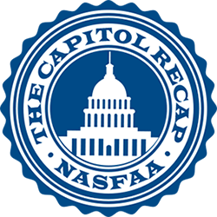
NASFAA Online Resources
NASFAA Legislative Tracker
Comprehensive list of all student aid-related legislation introduced in this session of Congress
Organized by subject area
The Capitol Recap
Monthly series in Today’s News that lists and summarizes newly-introduced legislation

Slide 37
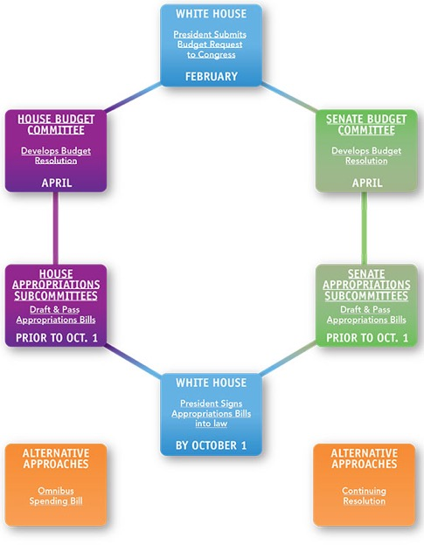

NASFAA Online Resources
Federal Budget & Appropriations Page
Interactive chart on the federal budget process
Budget and appropriations news archive from Today’s News
Off the Cuff Podcast
Weekly podcast with NASFAA staff and colleagues on student aid policy

